Slide 1
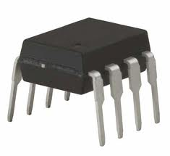
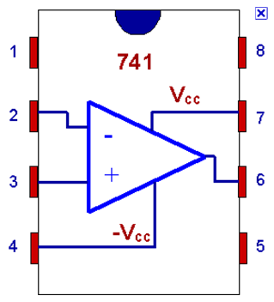
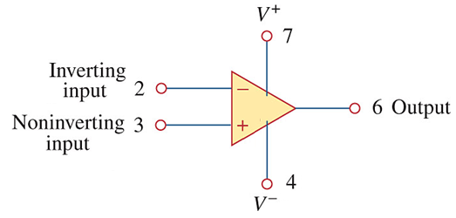
EBN 122 ELECTRICITY AND ELECTRONICS
Chapter 5
Operational Amplifiers
Op Amps

Slide 2
Operational Amplifier - Chapter 5
5.2 What is an Op Amp?
5.3 Ideal Op Amp
5.4 Configuration of Op Amp
5.5 Cascaded Op Amp
5.6 Application
– Digital-to Analog Converter

Slide 3
5.2 What is an Op Amp
It is an electronic unit that behaves like a voltage-controlled voltage source.
It is an active circuit element designed to perform mathematical operations of addition, subtraction, multiplication, division, differentiation and integration.
Hence: OPERATIONAL Amplifier

Slide 4
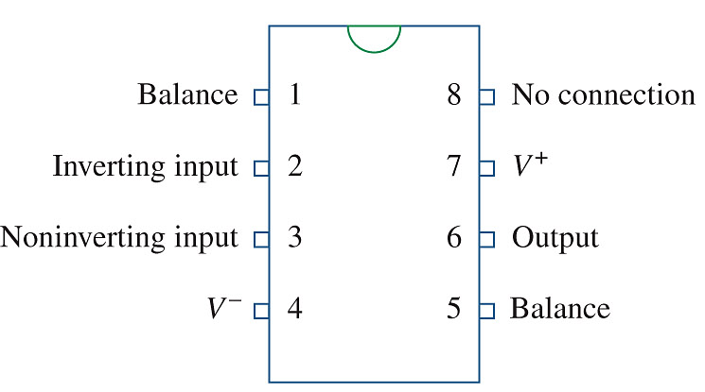
5.2 What is an Op Amp Pin Configuration and Circuit Symbol
Transistors, resistors, capacitors, diodes all integrated into an “IC”, integrated circuit.

Slide 5
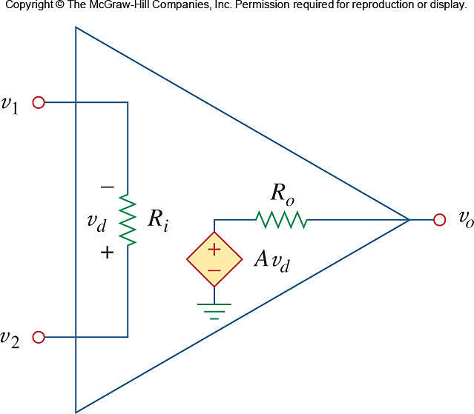
5.2 What is an Op Amp Equivalent Circuit model of a non-ideal Op Amp
Op Amp output:
v_{o} as a function of v_{d}
v_{d} = v₂ – v₁
v_{o} = Av_{d} = A(v₂ –v₁)
A = Open-loop voltage gain
Open-loop: No external feedback from output v₀ to input v_{d}
Typical ranges for op amp parameters
Parameter | Range | Ideal
A | 10⁵ – 10⁸ | ∞
R_{i} | 10⁵ – 10¹³ Ω | ∞ Ω
R_{o} | 10 – 100 Ω | 0 Ω
V_{CC} | 5 – 24 V
Supply voltage

Slide 6
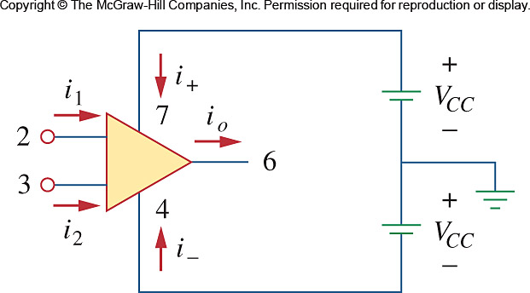
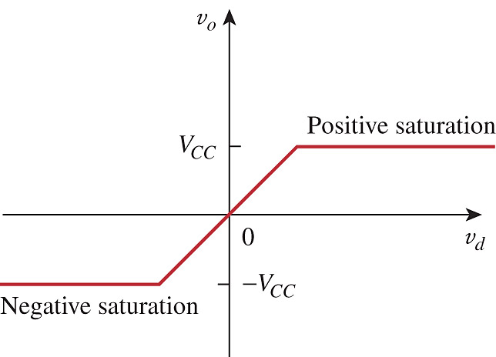
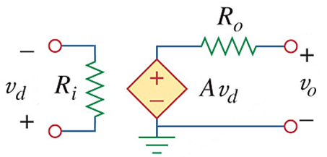
5.2 What is an Op Amp A Practical Limitation
Output cannot exceed |V_{CC}|
Linear region where v_{o} = Av_{d}
v_{d} = v₂ – v₁ = v⁺ – v⁻

Slide 7
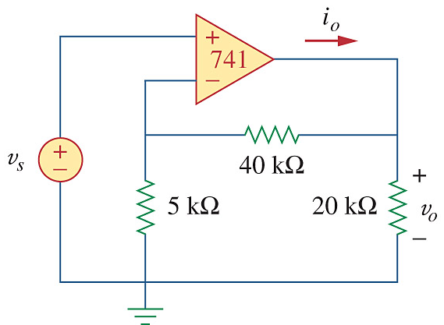
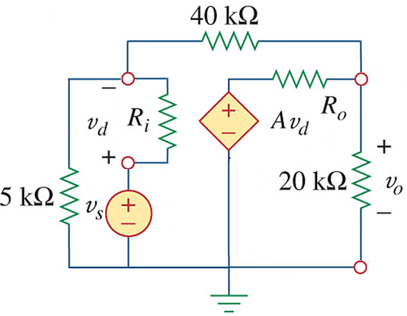
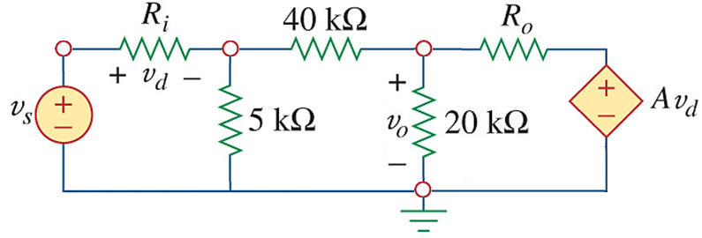
PP 5.1 Use a 741 Op Amp with A = 2×10⁵, R_{i} = 2 MΩ, R_{o} = 50 Ω.
Determine the closed-loop gain v_{o}/v_{s}
V₁
V_{o}
1 V

Slide 8
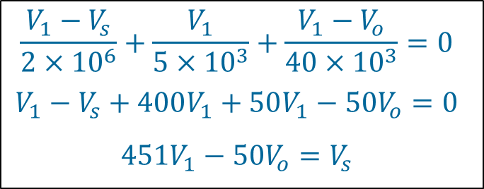
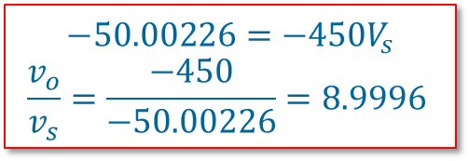
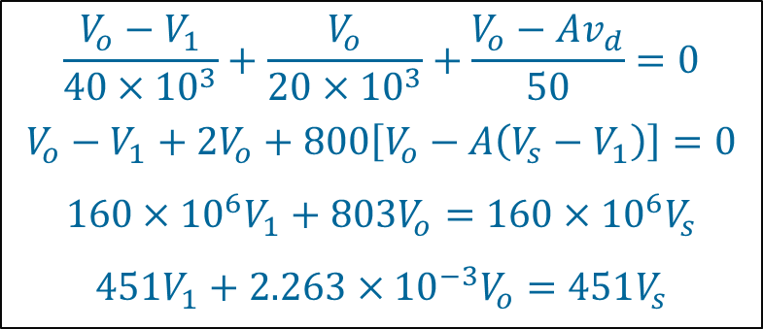
PP 5.1 cont… Use a 741 Op Amp with A = 2×10⁵, R_{i} = 2 MΩ, R_{o} = 50 Ω.
Determine the closed-loop gain v_{o}/v_{s}.
V₁
V_{o}
Nodal analysis:
KCL @ Node V₁
KCL @ Node V_{o}
$$\frac{V_{1}−V_{s}}{2×{10}^{6}}+\frac{V_{1}}{5×{10}^{3}}+\frac{V_{1}−V_{o}}{40×{10}^{3}}=0$$
$$V_{1}−V_{s}+400V_{1}+50V_{1}−50V_{o}=0$$
$$451V_{1}−50V_{o}=V_{s}$$
$$\frac{V_{o}−V_{1}}{40×{10}^{3}}+\frac{V_{o}}{20×{10}^{3}}+\frac{V_{o}−Av_{d}}{50}=0$$
$$V_{o}−V_{1}+2V_{o}+800\left[V_{o}−A\left(V_{s}−V_{1}\right)\right]=0$$
$$160×{10}^{6}V_{1}+803V_{o}=160×{10}^{6}V_{s}$$
$$451V_{1}+2.263×{10}^{−3}V_{o}=451V_{s}$$
1
2
1
2
$$−50.00226=−450V_{s}$$
$$\frac{v_{o}}{v_{s}}=\frac{−450}{−50.00226}=8.9996$$

Slide 9
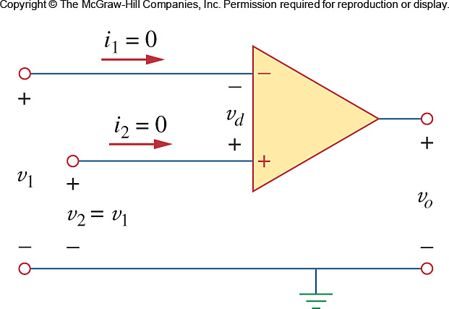
5.3 Ideal Op Amp
An ideal op amp has the following characteristics:
Infinite open-loop gain, A ≈ ∞
Infinite input resistance, R_{i} ≈ ∞
Zero output resistance, R_{o} ≈ 0
Since R_{i} = ∞:
i₁ = i₂ = 0
∴v_{d} = v₂ – v₁ = 0
∴ v₂ = v₁

Slide 10
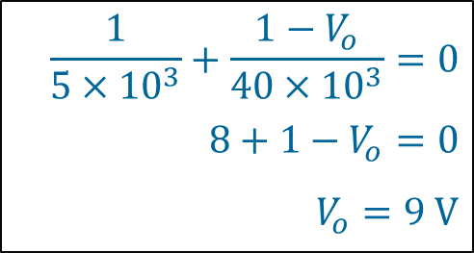
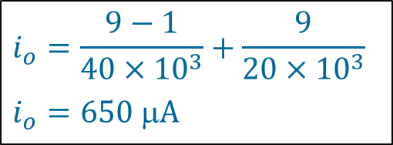
PP 5.1 for ideal opamp Assume v_{s} = 1 V and determine v_{o} and i_{o}.
1 V
1 V
Remember:
i₁ = i₂ = 0
v₊ = v-
9 V
v₊ = 1 V = v-
i₁ = i₂ = 0
∴v_{d} = v₂ – v₁ = 0
∴ v₂ = v₁
KCL @ Node v- to get V_{o}:
KCL @ Node V_{o} to get i_{o}:
$$\frac{1}{5×{10}^{3}}+\frac{1−V_{o}}{40×{10}^{3}}=0$$
$$8+1−V_{o}=0$$
$$V_{o}=9 V$$
$$i_{o}=\frac{9−1}{40×{10}^{3}}+\frac{9}{20×{10}^{3}}$$
$$i_{o}=650 A$$

Slide 11
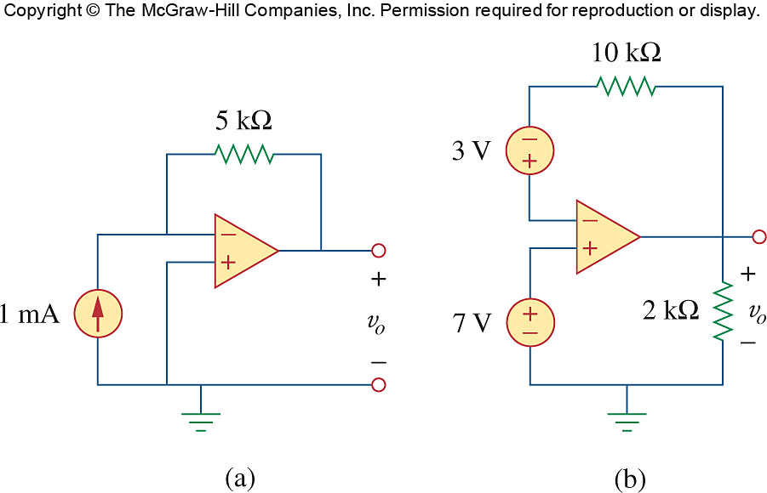
Problem 5.8 Determine v_{o} for both circuits

Slide 12
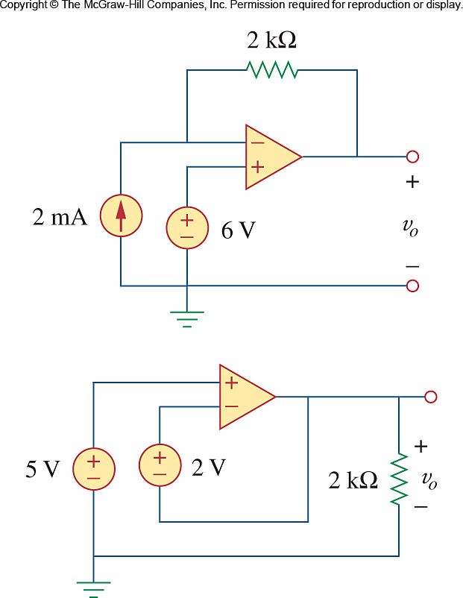
Problem 5.9 Determine v_{o} for both circuits

Slide 13
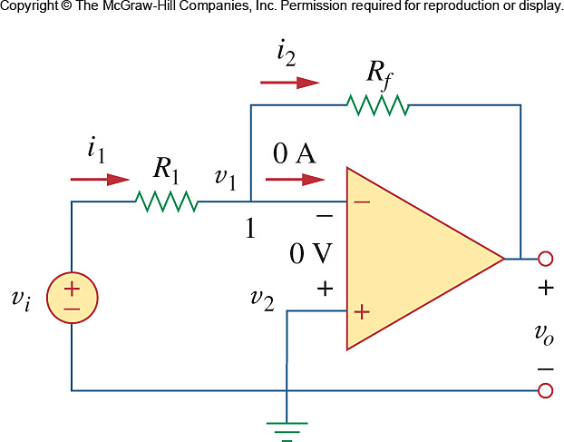
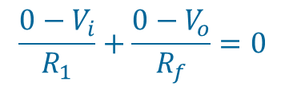

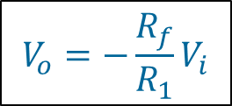
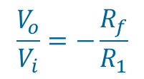
Ch. 5 L#2 5.4 Inverting Amplifier
Inverting amplifier reverses the polarity of the input signal while amplifying it
v₊ = v- = 0V
KCL at v-
$$−i_{1}+i_{2}=0$$
$$\frac{0−V_{i}}{R_{1}}+\frac{0−V_{o}}{R_{f}}=0$$
$$\frac{V_{o}}{V_{i}}=−\frac{R_{f}}{R_{1}}$$
$$V_{o}=−\frac{R_{f}}{R_{1}}V_{i}$$

Slide 14
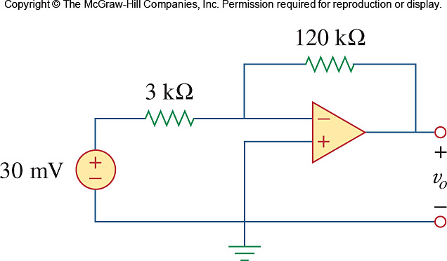
PP 5.3
Determine the output voltage and current through the feedback resistor.

Slide 15
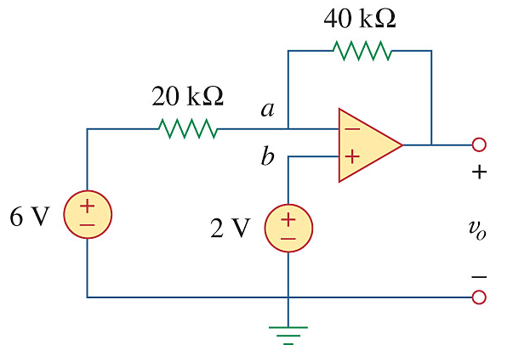
Example 5.4
Determine V_{o}.

Slide 16
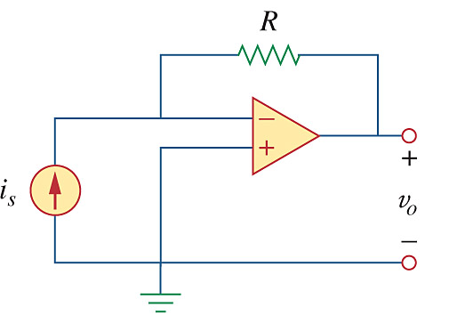


5.4 Inverting Amplifier
Special Case: Current-to-Voltage converter
v₊ = v- = 0V
0 V
0 V
KCL at v-: $i_{s}=\frac{0−V_{o}}{R}$
$$V_{o}=−i_{s}R$$

Slide 17
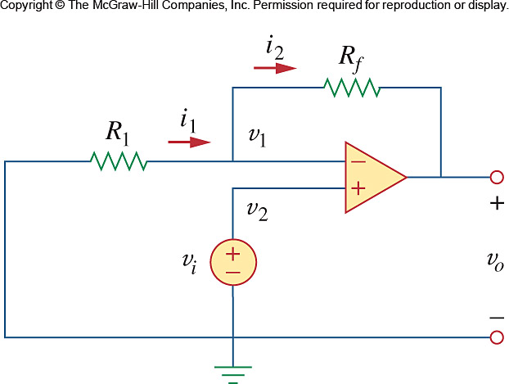
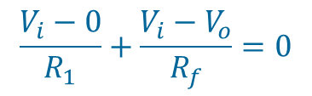
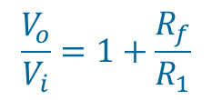
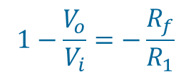
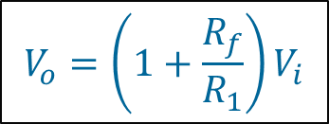
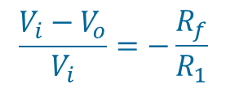
5.5 Non-inverting Amplifier
Non-inverting amplifier is designed to produce positive voltage gain
v₊ = v- = V_{i}
KCL at v-
v_{i}
$$\frac{V_{i}−0}{R_{1}}+\frac{V_{i}−V_{o}}{R_{f}}=0$$
v_{i}
$$\frac{{V_{i}−V}_{o}}{V_{i}}=−\frac{R_{f}}{R_{1}}$$
$$1−\frac{V_{o}}{V_{i}}=−\frac{R_{f}}{R_{1}}$$
$$\frac{V_{o}}{V_{i}}=1+\frac{R_{f}}{R_{1}}$$
$$V_{o}=\left(1+\frac{R_{f}}{R_{1}}\right)V_{i}$$

Slide 18
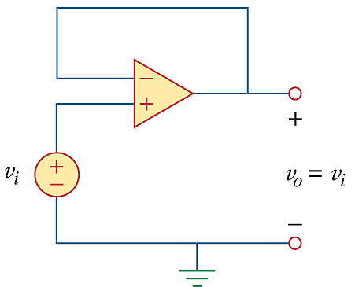
5.5 Non-inverting Amplifier
Special Case: Voltage Follower
Output = Input
Advantage: V_{i} sources a very low current while V_{o} can source high current. (Remember Op Amp is an Active element getting energy via V_{CC} and –V_{CC}).
Circuit is used a BUFFER to isolate one stage of a circuit from another.

Slide 19
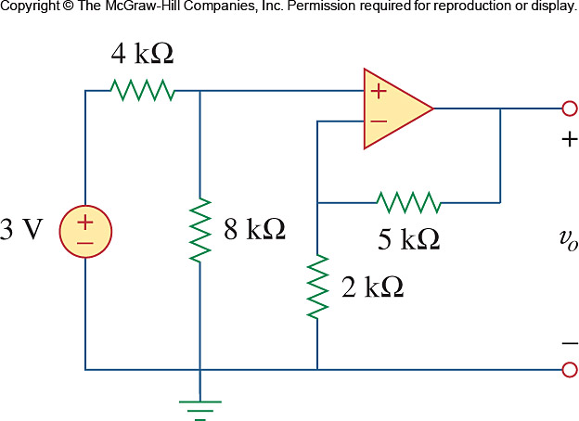
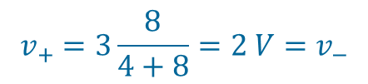


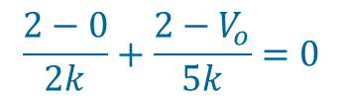
PP 5.5
Calculate v_{o}.
i₊
2 V
2 V
i₊ = 0 A
Because of this, the 3V is divided across the 4 kΩ and 8 kΩ resistors, hence a basic voltage divider.
So:
$$v_{+}=3\frac{8}{4+8}=2 V=v_{−}$$
KCL @ v-:
$$\frac{2−0}{2k}+\frac{2−V_{o}}{5k}=0$$
$$10+4−2V_{o}=0$$
$$V_{o}=7 V$$

Slide 20
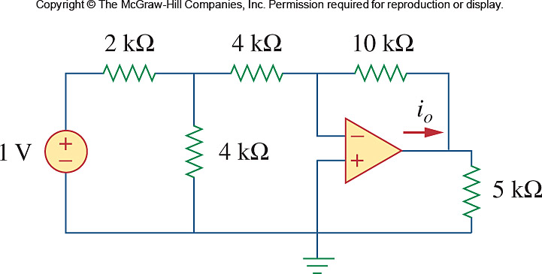
Problem 5.19
Calculate i_{o}.

Slide 21
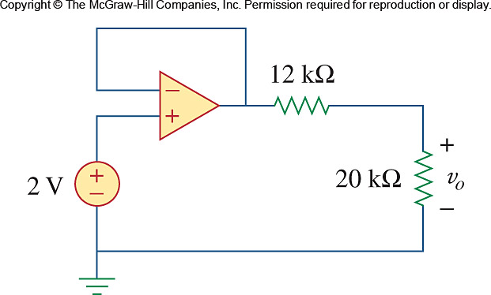
Problem 5.25
Calculate v_{o}.

Slide 22
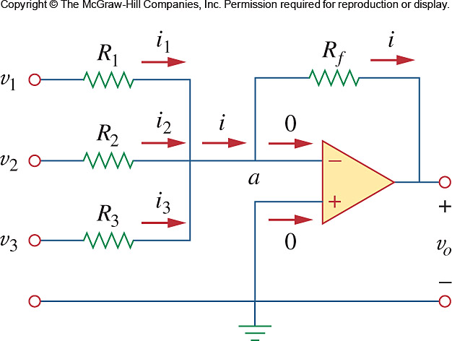
Ch. 5 L#3 5.6 Summing Amplifier
Summing Amplifier is an op amp circuit that combines several inputs and produces an output that is the weighted sum of the inputs.
Basic configuration of an inverting amplifier but with multiple inputs.

Slide 23
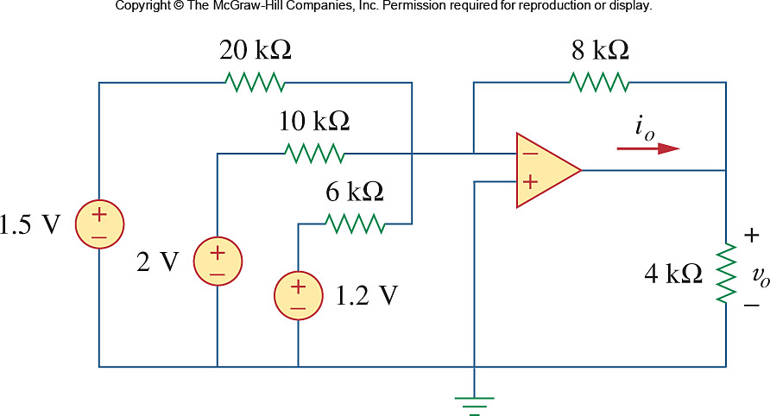
PP 5-6
Determine v_{o} and i_{o} for the following circuit:

Slide 24
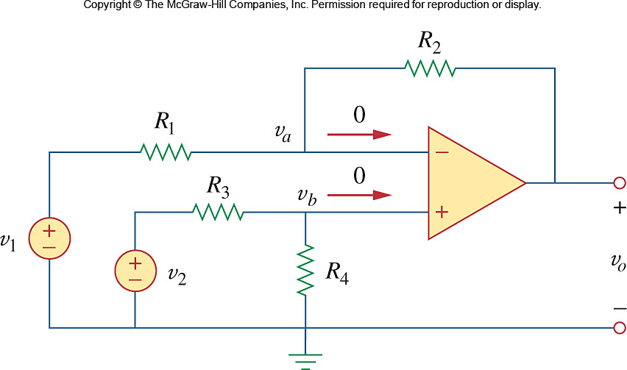
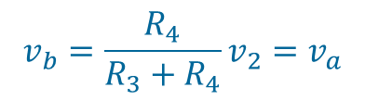
Ch. 5 L#3 5.7 Difference Amplifier
Difference amplifier is a device that amplifies the difference between two inputs but rejects any signals common to the two inputs.
Combination of the inverting and non-inverting op amps.
$$v_{b}=\frac{R_{4}}{R_{3}+R_{4}}v_{2}=v_{a}$$
See derivation from 1st principles in textbook p187 and p188
If R₁/R₂ = R₃/R₄: V_{o} = 0 if V₁ = V₂
If R₂ = R₁ and R₃ = R₄: V_{o} = V₂ – V₁

Slide 25
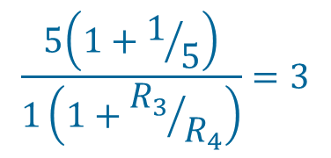
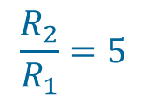

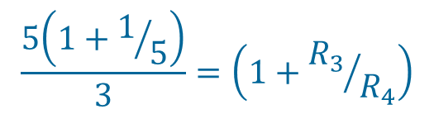
Example 5.7
Design an Op Amp circuit with inputs v₁ and v₂ such that v_{o} = -5v₁ + 3v₂
Design 1: Using only 1 Op Amp
v_{o} = 3v₂ – 5v₁
$$\frac{R_{2}}{R_{1}}=5$$
$$\frac{5\left(1+1/5\right)}{1\left(1+{R_{3}}/{R_{4}}\right)}=3$$
$$\frac{5\left(1+1/5\right)}{3}=\left(1+{R_{3}}/{R_{4}}\right)$$
$$2−1=1={R_{3}}/{R_{4}}$$
Choose R₃ = R₄ = 2 kΩ

Slide 26
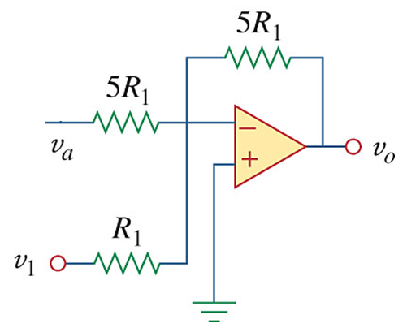
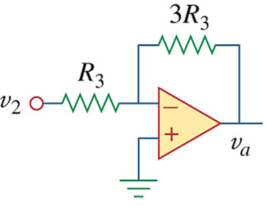
Example 5.7
Design an Op Amp circuit with inputs v₁ and v₂ such that v_{o} = -5v₁ + 3v₂
Design 2: Using 2 Op Amps
Build an inverting amp to obtain v_{a} = -3v₂.
2. Feed the output v_{a} into a summing amplifier along with v₁.
v_{a} = – 3R₃/R₃ × v₂
= – 3v₂
v_{o} = – (5R₁/R₁ × v₁ + 5R₁/5R₁ × v_{a})
= – 5v₁ – v_{a}
= – 5v₁ – (– 3v₂)
= – 5v₁ + 3v₂

Slide 27
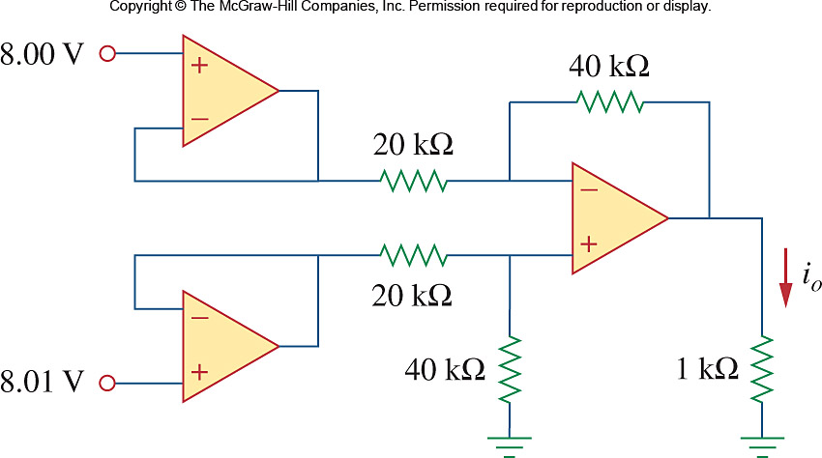
PP 5-8
Determine i_{o} for the following circuit:
V_{o}

Slide 28
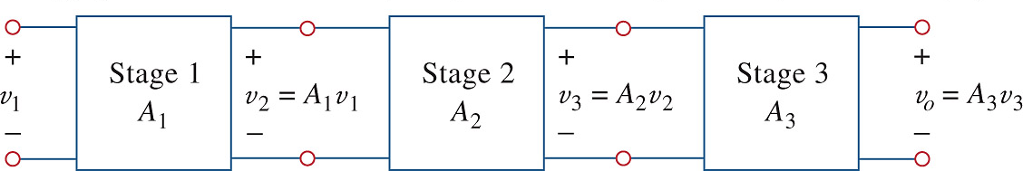
Ch. 5 L#4 5.8 Cascaded Op Amp Circuits
It is a head-to-tail arrangement of two or more op amp circuits such that the output to one is the input of the next.
$$v_{o}=A_{3}v_{3}=A_{3}\left(A_{2}v_{2}\right)=A_{3}A_{2}\left(A_{1}v_{1}\right)$$
Total Amplification A = A₁A₂A₃

Slide 29
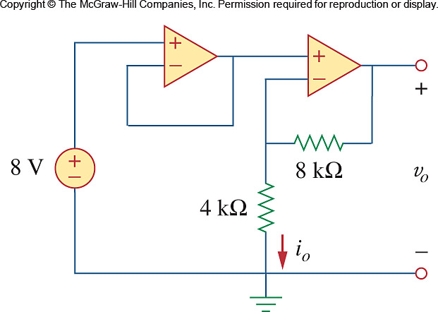




PP 5-9
Determine v_{o} and i_{o}.
Voltage Follower or Buffer
v₊ = v- = 8 V
KCL at v-
Non-Inverter
$$\frac{8−0}{4k}+\frac{8−v_{o}}{8k}=0$$
8 V
8 V
$$16+8=v_{o}$$
$$v_{o}=24 V$$
$$i_{o}=\frac{v_{−}}{4k}=\frac{8}{4k}=2 mA$$

Slide 30

PP 5-10
If v₁ = 4 V and v₂ = 3 V, determine v_{o}.
4 V
3 V

Slide 31
PP 5-10 (continued)
If v₁ = 4 V and v₂ = 3 V, determine v_{o.}

Slide 32

Problem 5-39
Determine v₂ such that v_{o} = -16.5 V.

Slide 33

Problem 5-39
If v₁ = 1 V and v₂ = 2 V, determine v_{o}.

Slide 34

Problem 5-59
Determine v_{o}/v_{s} if R = 20 kΩ.

